Slide 4
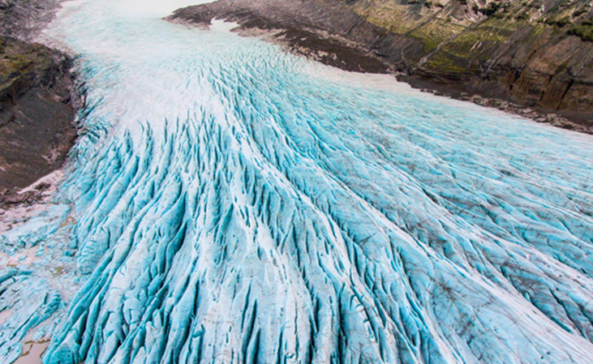
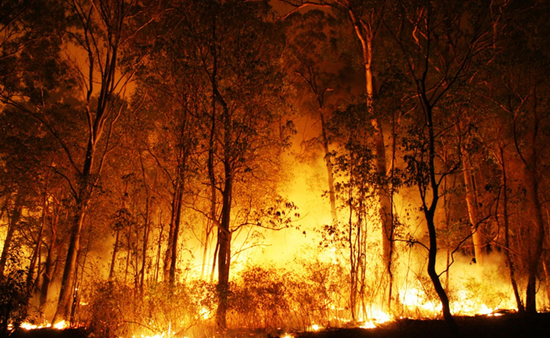
Introduction
The Bancroft Minden Forest has been shaped by glaciers, fire and settlement. It has also endured a long history of past utilization. These influences are what has formed the current forest seen today

Slide 5
HISTORICAL USES OF FOREST RESOURCES
Pre-European Settlement

Slide 6
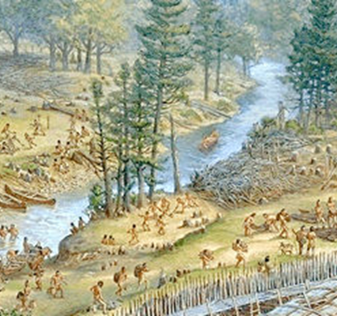
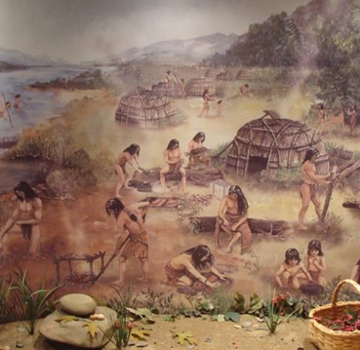
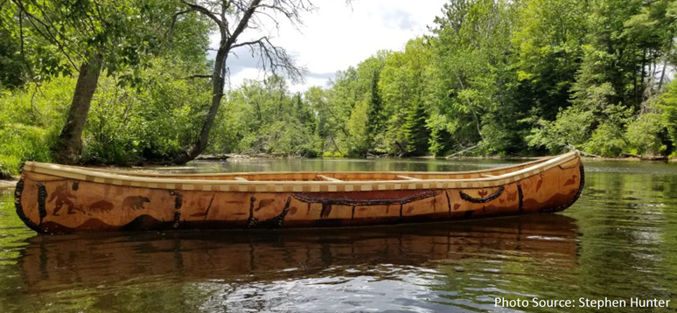
Indigenous communities lived in present-day Ontario for thousands of years before Europeans arrived
Most of the land within the BMF is the traditional lands of the Anishinaabeg Peoples
Forests were used as a primary source of food, shelter and cooking fuel
Most of the ‘virgin’ or ‘pristine’ pine forests perceived by the settlers originated from Indigenous population 200 years earlier

Slide 7
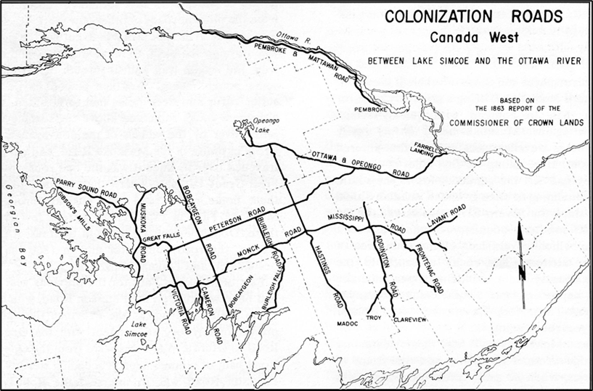
POST EUROPEAN SETTLEMENT
Land Tenure
European “discovery” of Ontario began in the 17th century
During the 1850’s land within the BMF was surveyed
Public Lands Act (1853) – formalized the promise of land in central and eastern Ontario to settlers

Slide 8
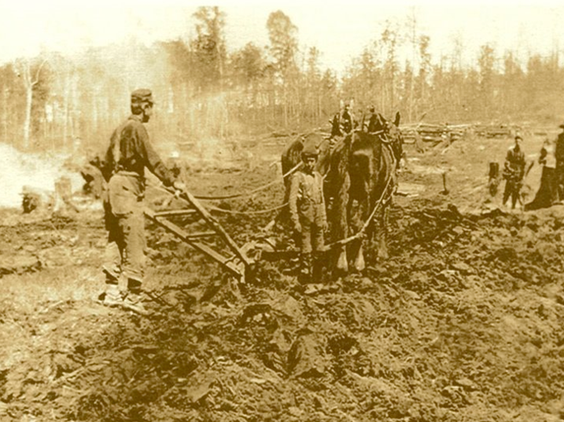
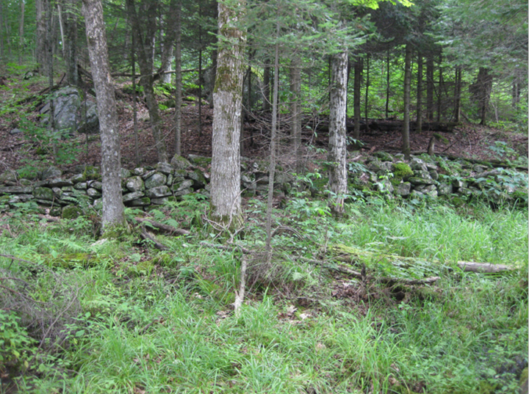
Poor Soil Conditions
Farmland Reverted to Forests

Slide 9
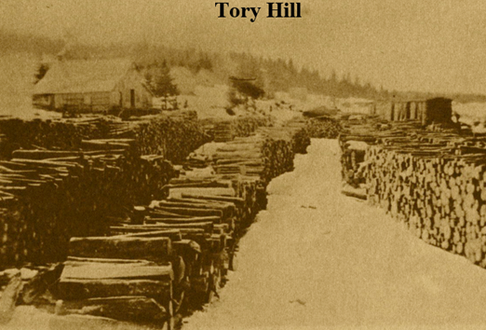
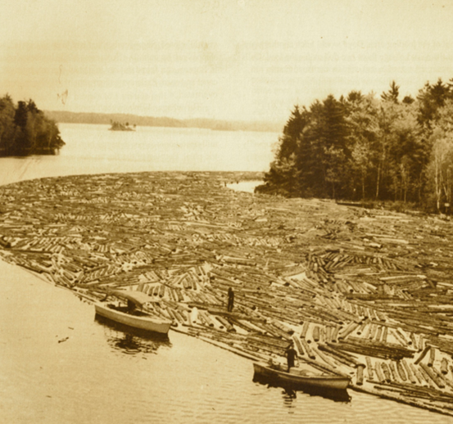
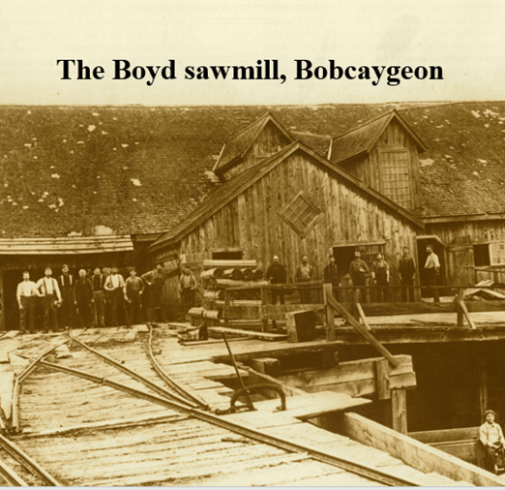
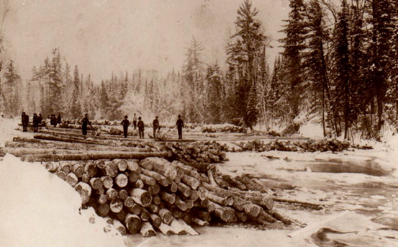
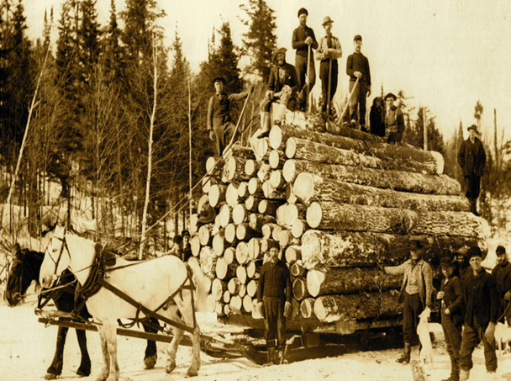
LOGGING OR CLEARING OF PINE FORESTS

Slide 10
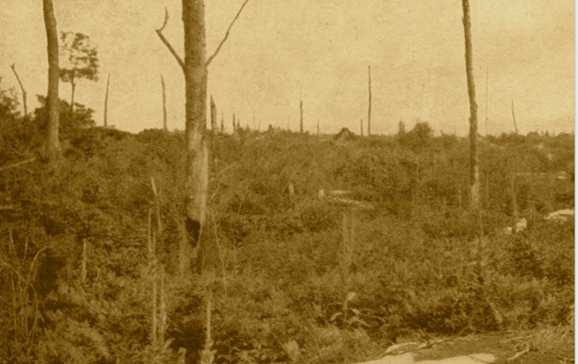
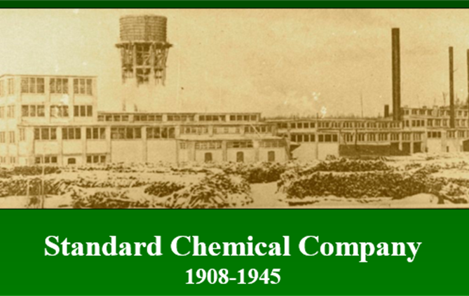
HARDWOOD MANAGEMENT 1908 - 1950
‘Chemical Wood Era’
High-grading
Hard maple replaced yellow birch as the most heavily cut species

Slide 11
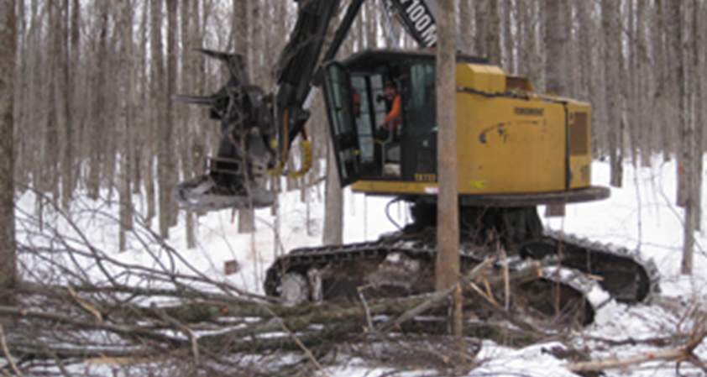
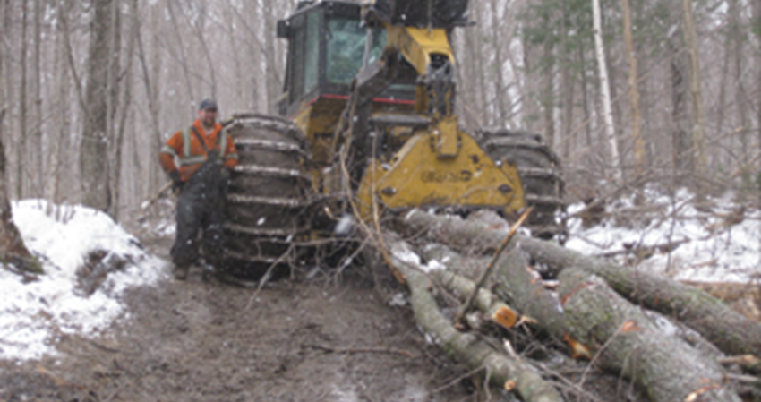
The 1950’s marked the beginning of forest management planning at the unit level
The Ontario Ministry of Natural Resources Timber Production Policy (1970s) became a source of staffing, funding, and production targets
Forest management approaches in the 1970s started the “reverse high-grade” approach to improve forest quality and vigor. This required the use of tree markers and careful logging practices. Selection and shelterwood management systems were developed and implemented.

Slide 12
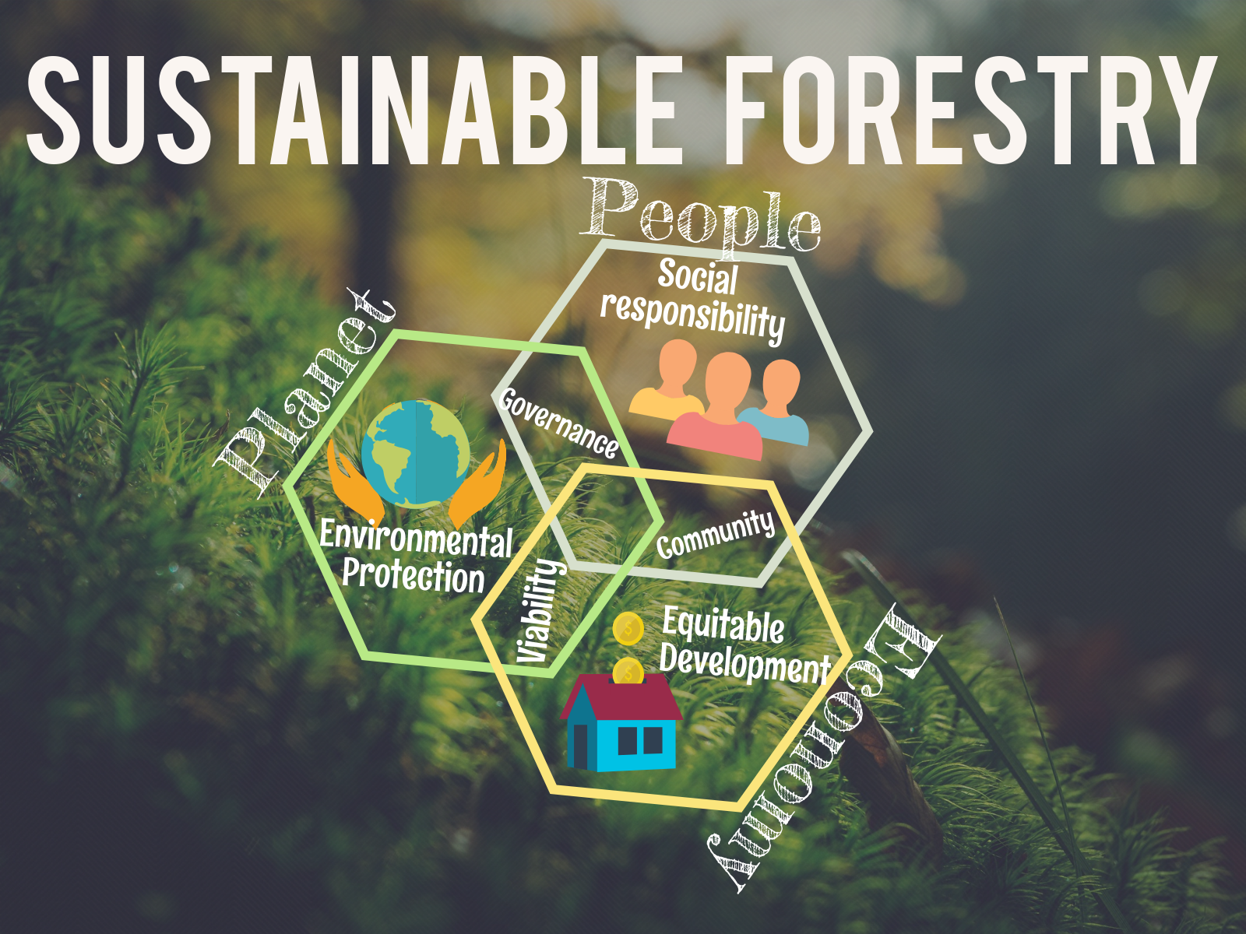

Slide 16
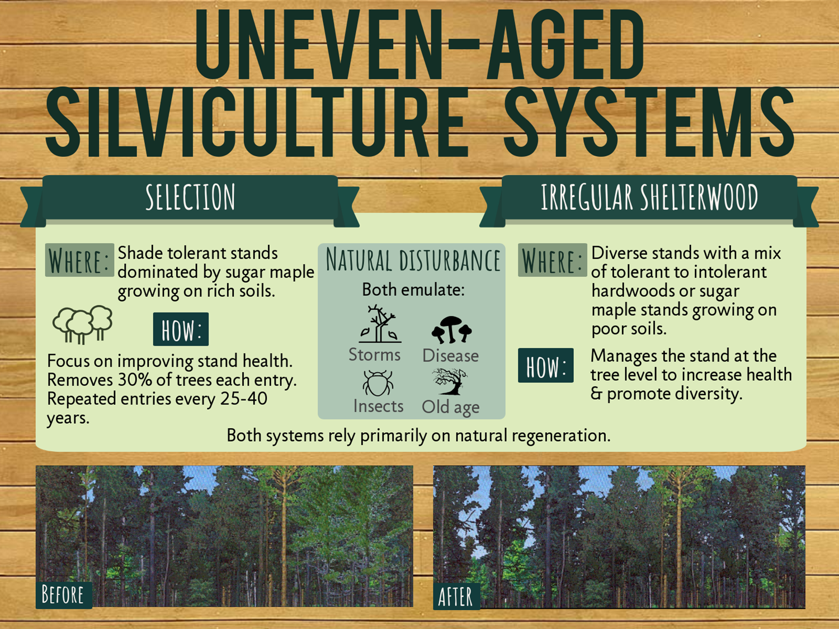

Slide 17
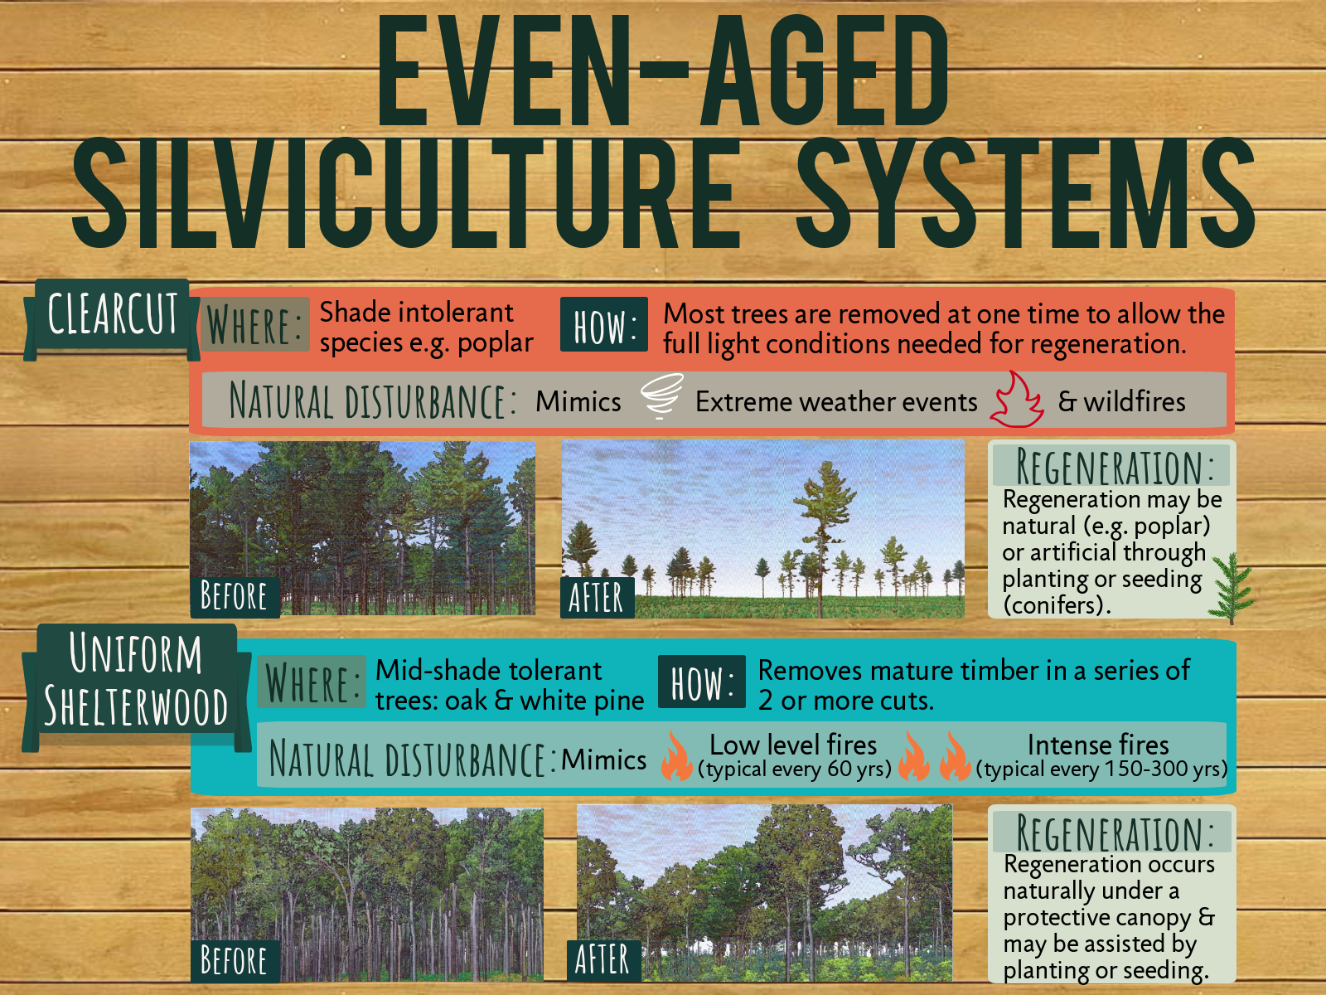

Slide 20
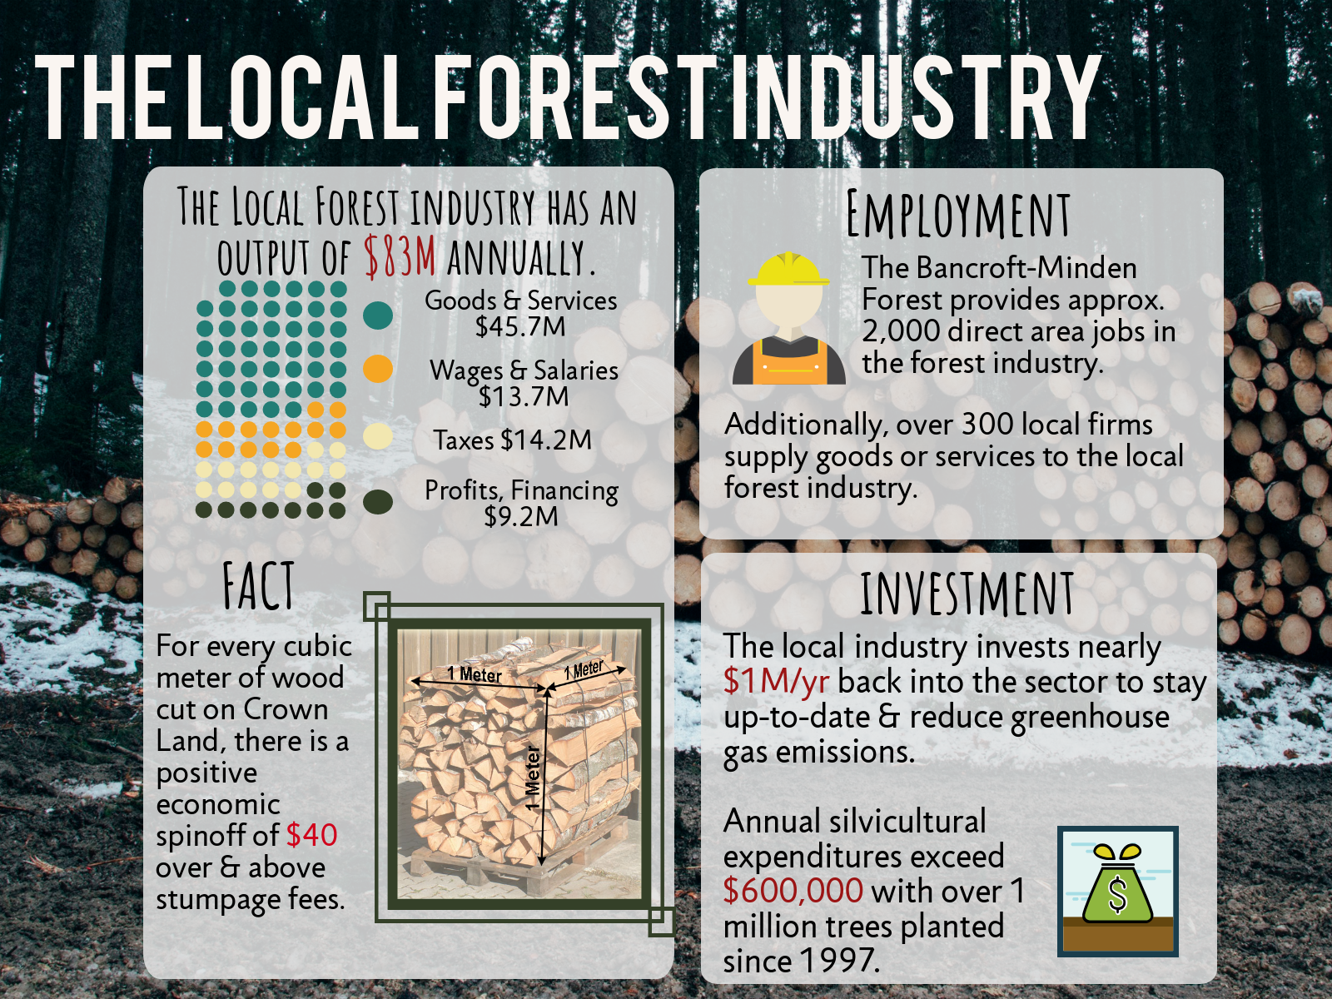

Slide 21
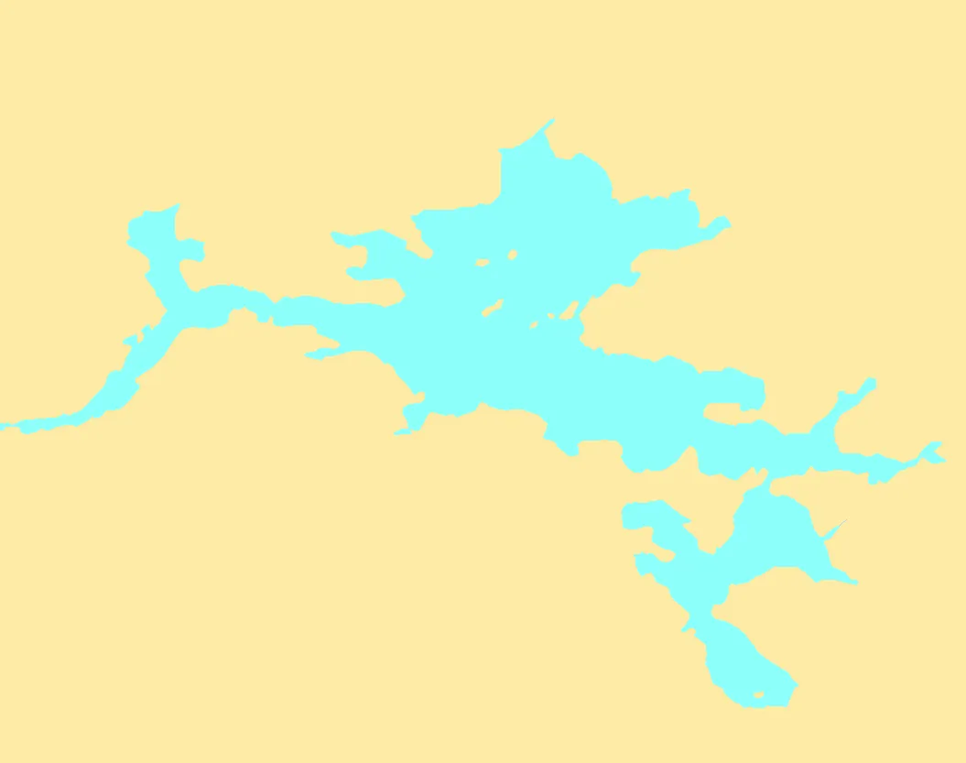
Block 1703

Slide 22
